Slide 1
Happiness Meter
A solution to a problem retail didn’t know it had

Slide 2
It’s all about the customer…
Retailers have become obsessed about the “Customer Experience”.
They are looking for new ways to engage with customers, and make sure they are happy, because happy customers come back, or buy more.
For years, they have been recording movement and behavior in stores. It’s all on tape or hard disc. They know so much about what their customers do, and want. If only they would look at it…
What if you could tell how customers felt and react, in REAL TIME?

Slide 3
“But I can’t spend time watching people…”
A year ago, that was true. A typical supermarket has in excess of 100 CCTV cameras, always on. Who can look at 2400 hours of footage every day? If you did, could you make determinations on behaviour?
If you think that’s a lot, most Westfield centres have over 1000, and that’s just the ones they control.
Image Recognition and AI make it possible to automate the use of this stream of data. Every frame can be broken down into a set of metrics

Slide 4
Introducing the Happiness Meter
Let’s take the raw stream, clean it up and gather some basic human behaviour data.
The Amazon Rekognition service does the heavy lifting for us.
Because we are building statistics, not tracking movement, our storage levels are lower.

Slide 5
How can we use it?
If people around a particular location don’t look happy, maybe they can’t find what their looking for?
Is our customer base changing?
Are the enough checkouts open?
Is there a problem with the toilets?

Slide 6









Solution Design
Dynamic Configuration*
Config Bucket
Rekognition
Analytics
ssl
Storage Rules
Intelligent Cameras
Cognito*
Data Bucket
Image Event Function
Statistics DB
* Work in progress

Slide 7
The nuts and bolts …and screws, and wires

Slide 8
How Does It work?
One or more cameras take HD photographs on a schedule (say 60 seconds during business hours)
On-board logic does a “find face” to avoid sending empty or poor frames to AWS.
Images with faces are pushed to a geographically local S3 bucket.
Lambda calls Rekognition to find ‘Emotion’ data in the face(s) in a frame.
Stats are stored to Dynamo Table
Stats tool of choice can create real-time customer emotion dashboard.

Slide 9
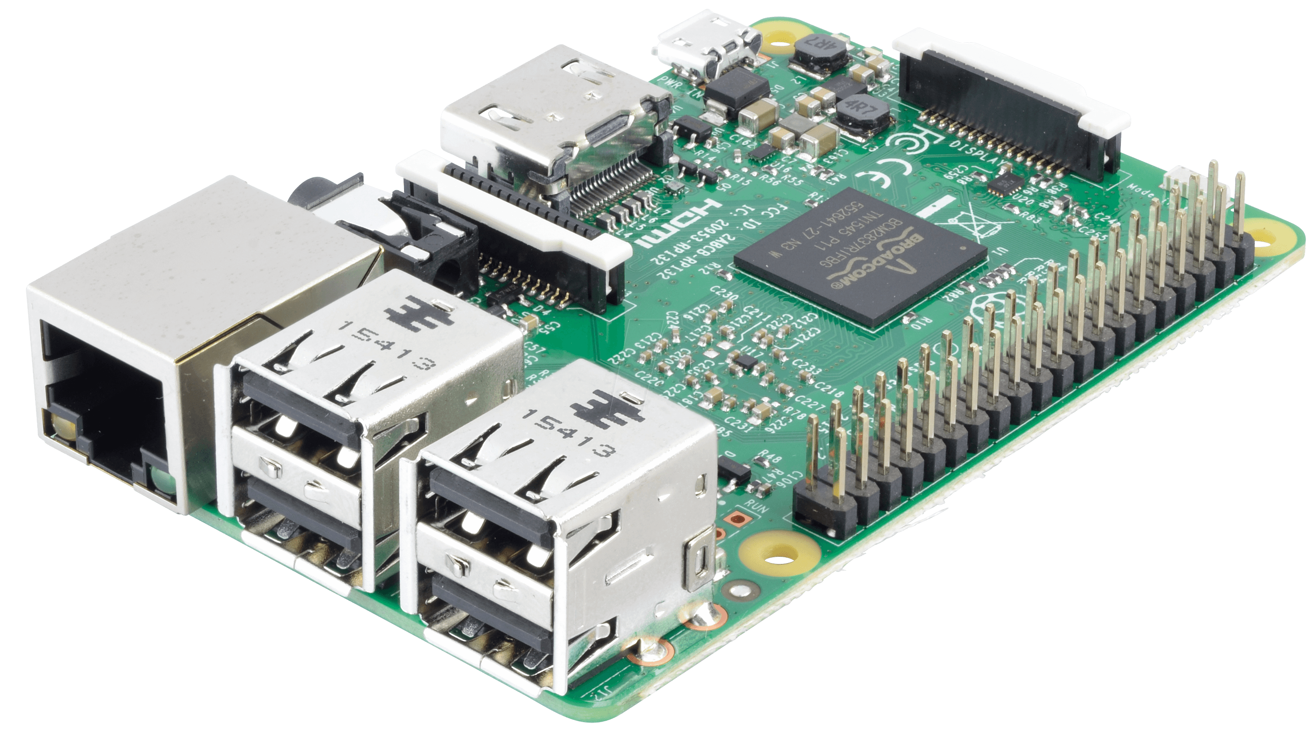
PoC Design
The entire solution was built in 3 evenings.
Created a “Smart Camera” using a Raspberry Pi 3 (because I had one) and a SD Microsoft Webcam.
Simple Python code on the RPi manages camera, OpenCV face recognition and S3.
It can also download new configuration and scripts from S3, so it becomes essentially self-configuring.

Slide 10
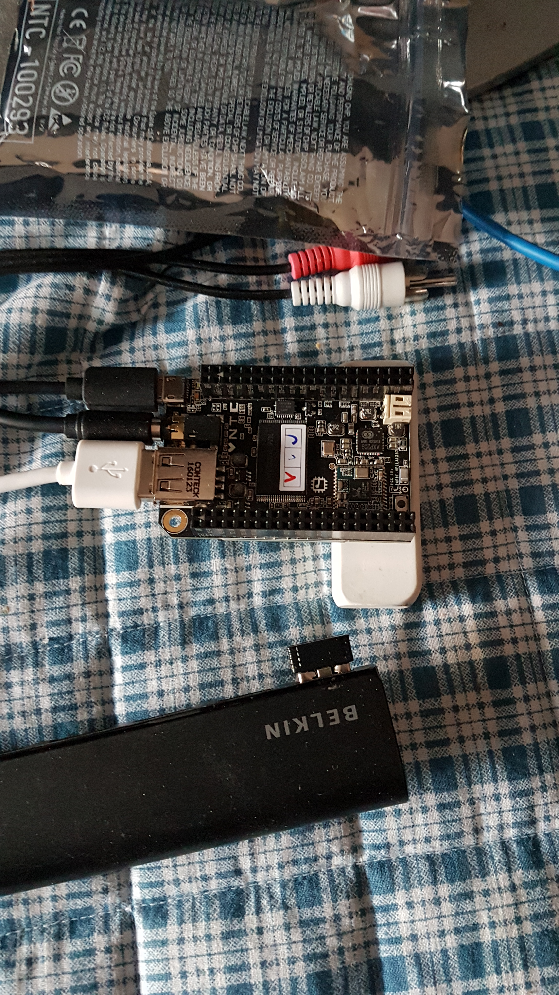
Mk II Design
Based on the first version, but smaller and cheaper.
Uses the $9 “Chip” module from www.getchip.com.
Took about 30 minutes to complete, based on Mk I.
Still using a USB Webcam.

Slide 11
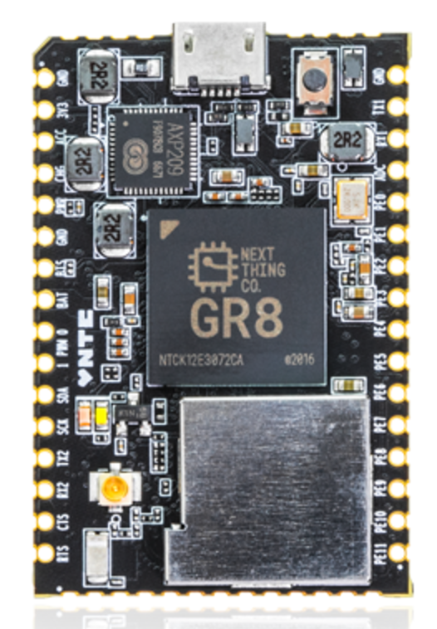
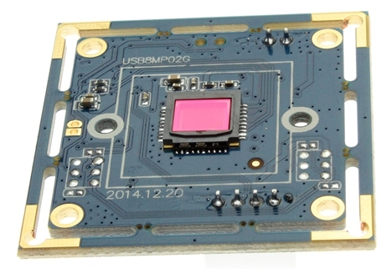
Mk III Design (Waiting on Parts)
More compact electronics.
4K camera!
Allow C-Mount lenses

Slide 12
Isn’t this a bit creepy?
No. Because we’re not storing photos. Only statistical data. S3 policy deletes images automatically after 24 hours by default.
This solution could hook existing CCTV streams. Customers are already being recorded and monitored. This is just a use for a previously untapped information stream.

Slide 13
But will it scale?
Yes. It’s a modern cloud-only architecture. Every component in the processing side can be dynamically expanded.
For a store open 12 hours/day, 2 cameras would cost around $US1 per day to process
The biggest issue would be bandwidth from remote feeds.

Slide 14
What’s been done so far?
Camera code.
Lambda to process images and store in DynamoDB.
CloudFormation for deployment.
Field testing with the help of a friendly business owner.

Slide 15
What’s left to do?
Produce some nice looking dashboards (not my strong point)
Use a frame grabber instead of a dedicated camera. Allows us to plug into existing video streams.
Build the whole thing into a camera perhaps? (Mk III makes this possible!)
Extend the data set. Perhaps capture gender and age groups. We already have the data, just need to work out what to do with it.
Figure out the financials

